Slide 1
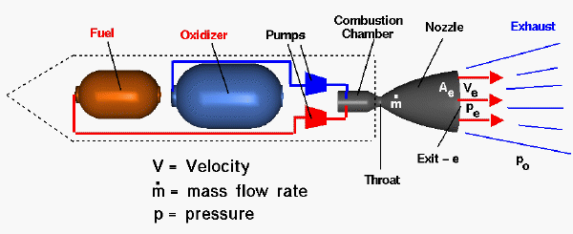
Rocket Physics Application of Conservation of Momentum
LabRat Scientific
© 2018

Slide 2
In this lesson we will learn how to estimate the velocity of a rocket based on a specific exit velocity of the rocket motor exhaust and the total mass of the propellant being used. This concept relies on the idea of “Conservation of Momentum”.
V_{P} x M_{P}
V_{R} x M_{R}

Slide 3
Conservation of Momentum
The rocket exhaust has mass and it leaves the rocket at a very high velocity. As such, the exhaust gas has Momentum (= Mass x Velocity)…
This momentum is transferred to the rocket. Newton’s Second Law (and the law of conservation of momentum) says the momentum of the rocket will be equal and opposite the momentum of the exhaust gas.
Conservation of Momentum is depicted mathematically as:
Velocity_{Propellant} x Mass_{Propellant} = Velocity_{Rocket} x Mass_{Rocket}
V_{P} x M_{P}
V_{R} x M_{R}
If we know the mass of the fuel and the exhaust velocity, we can estimate the final velocity of the rocket after the motor burns out.

Slide 4
Example: What is the delta-V of a 10,000 lb (dry) orbital rocket that burns 5,000 lb of fuel with an exhaust exit velocity of 3,000 ft/sec?
Velocity_{Propellant} x Mass_{Propellant} = Velocity_{Rocket} x Mass_{Rocket}
Velocity_{Propellant} x Mass_{Propellant}
Velocity_{Rocket} = ----------------------------------------------------
Mass_{Rocket}
3,000 Ft/Sec x 5,000 lb
Velocity_{Rocket} = ----------------------------------------------
10,000 lb
Yes, you are right, Pound is not a unit of Mass, but do you really want to work in “slugs”… Besides, the units cancel anyway!
Velocity_{Rocket} = 1,500 Ft/Sec (1,023 MPH)
Again, this is an approximate value since the mass of the rocket is changing over time as the propellant is ejected… Should we use the dry weight, the wet weight (rocket + fuel), or something in between?

Slide 5
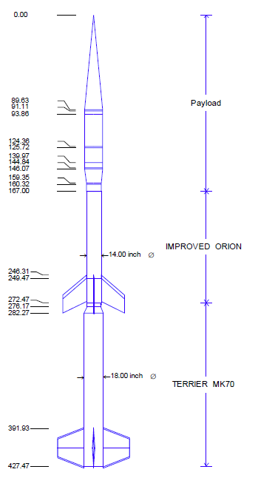
Validation of the theory using data from a NASA Terrier-Orion Sounding Rocket
Terrier-Orion Sounding Rocket (analysis of 1st stage burn)
Total Lift-Off Weight: 4,005 lbs
Terrier Propellant Weight: 1,511 lbs
Exhaust Exit Velocity: 7,900 ft/sec
Using Conservation of Momentum
Velocity_{Propellant} x Mass_{Propellant} = Velocity_{Rocket} x Mass_{Rocket}
Velocity_{Propellant} x Mass_{Propellant}
Velocity_{Rocket} = ----------------------------------------------------
Mass_{Rocket}
7,9000 Ft/Sec x 1,511 lb
Velocity_{Rocket} = ----------------------------------------------
4,005 lb
Velocity_{Rocket} = 2,980 Ft/Sec ( 2,032 MPH )

Slide 6
Actual NASA performance simulations of the Terrier-Orion sounding rocket indicate the burnout velocity at the end of Terrier (first stage) burn is 2,190 MPH. The 2,032 MPH (estimated) value is pretty close to the 2,190 MPH velocity generated by flight simulations, so it looks like the theory gives a pretty good estimate
The difference is due to many factors, most of which tend to cancel out (i.e. aerodynamic and gravity losses not accounted for in the conservation of momentum approach, and the fact that the momentum approach does not account for the time varying system mass)...

Slide 7
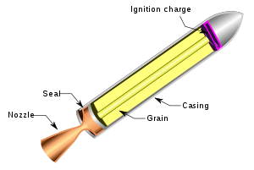
Questions?

